Slide 1
Chemistry: Bright carrier in Past, Present and Future……..

Slide 2
Why we Need
course Counseling ?

Slide 4
Counseling is an integral part of an over-all programme of guidance.
Need of counseling:-
To help in the total development of the student. Proper motivation, clarification of goals and ideas, their basic potentialities….
To help in the proper choices of courses…
..
3) To help in the proper choices of carvers…
4) To help in the students in vocational development…
5) Development and readiness for choices and changes to face new challenges????
6) To minimize the mismatching between education and employment ..
7) To motivate the youth for self employment..
8) To help fresher's establish proper identity..

Slide 5
Counseling is an integral part of an over-all programme of guidance.
Need of counseling:-
To help in the total development of the student. Proper motivation, clarification of goals and ideas, their basic potentialities….
To help in the proper choices of courses…
..
3) To help in the proper choices of carvers…
4) To help in the students in vocational development…
5) Development and readiness for choices and changes to face new challenges????
6) To minimize the mismatching between education and employment ..
7) To motivate the youth for self employment..
8) To help fresher's establish proper identity..

Slide 6
8) To help in their period of turmoil and confusion..
9) Helps to determine strengths and weaknesses…..
10) Educational guidance and support
11) Goal setting for greater results

Slide 8
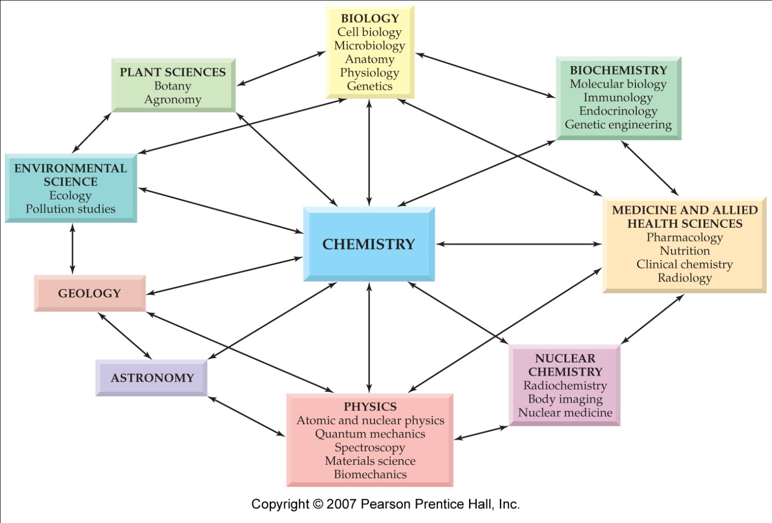
Chemistry: The Central Science
Better things for better living through chemistry…….

Slide 9
Almost every field in the world use chemicals as a part in some or other ways…..So the need for chemists also is in high demand…..
Higher Study….
MSc /other Diploma/Job Oriented Courses
Government Jobs
Private/Industrial Sector
B.Sc. Career

Slide 10
Higher studies
Why Choose Master of Science (Chemistry) ?
Diverse career opportunities.
Finest and reputed profession.
High paid jobs in government and private sectors…
M.Sc. Chemistry: Course Highlights
Full Form | Master of Science in Chemistry
Duration | 2 years
Eligibility | Graduation (Chemistry as one of the main subjects)
Admission Process | 1) Entrance Exams 2) Direct Admission to College
Top Entrance Exams | 1) IIT JAM ( Joint admission test for M.Sc.)
 | 2) BHU Entrance Exam, Indian Institute of Science MSc
 | 3) Chemistry Entrance exams

Slide 11
Some of the academic PG degrees…
8.MSc Organic Chemistry
9.MSc Physical Chemistry
10.MSc Theoretical Chemistry
11.MSc Drug Chemistry
12.MSc Pharmaceutical Chemistry
13.MSc Physical & Materials Chemistry
14.MSc Bio-Chemistry
15.MSc Master’s degree in Computational Chemistry
1.MSc Analytical Chemistry
2.MSc Applied Chemistry
3.MSc General Chemistry
4.MSc Inorganic Chemistry
5.MSc Instrumental Analysis
6.MSc Medical Chemistry
7.MSc Molecular Chemistry

Slide 12
Prominent Research-based institutes in the country for M.Sc.
1)Indian Institute of Science (IISc): IISc in Bangalore MSc and Integrated M.Sc.)
2) Indian Institutes of Science Education and Research (IISER) 07
Kolkata, Pune, Mohali, Bhopal, Tirupati, Thiruvananthapuram, and Berhampur.
3) Indian Institute of Technology IITs (23 IITs)
4) National Institutes of Technology NITs 31 NITs (20 old + 11 new)
5)National Institute of Science Education and Research (NISER) Jatani (Odisha) 6)Various State and Central Universities ( Entrance Test) 7)Various Colleges (Aided /Non aided) ( Entrance Exam)
Eligibility:-A) M.Sc or Integrated Ph.D (MSc & Ph.D):-JAM/JEST(Joint Entrance Screening Test) B)For Ph.D.: -GATE/ UGC NET/ CSIR NET/equivalent …..Should Clear JAM exam based on that we decide which to select IIT,
IISc, IISER,NIT and IISc…

Slide 13
Various P.G. Diploma courses after B.Sc. Chemistry (01 Year)
1.PG diploma in Industrial chem.
2. PG diploma in Analytical chem.
3.PG Diploma in Clinical research
4 PG Diploma in Bio-Informatics
5. PG Diploma in Biochemistry.
6.PG Diploma in Applied chem. 7.PG Diploma in Drug Chemist.
8.PG Diploma in Microbiology. 9.PG diploma in Bioanalytical Sciences 10.PG Diploma in Industrial Chemical Quality Control
11.PG Diploma in Wine, Brewing and Alcohol Technology (2 Yr) 12.PG Diploma in Sugar Tech. (2.5 Yr) 13.PG Diploma in Sugar Instrumentation Technology (1.5yr) 14.PG Diploma in Industrial Fermentation &Alcohol Tech.(22 Month) 15. Sugar Manufacture (Certificate Course of 01Yr) 16 .PG Diploma in Industrial Analytical Chem.
.

Slide 14
Government Jobs after B.Sc.
Central Government Jobs after B.Sc. Chemistry:- A)Defense Research Development and Organization(DRDO)Scientific Assit. B) Council of Scientific and Industrial Research (CSIR) C) Bhabha Atomic Research Centre (BARC). D) Common Defense Exam conducted by UPSC E) UPSC for graduates is Indian Administrative Services (IAS). F) Staff Selection Commission (SSC) G) Assistant Central Intelligence Officer exam(Ministry of Home Affairs) H) Air Force Common Admission Test (AFCAT) I) Common Admission Test (CAT) The Indian Institutes of Management (IIMs) for selecting students for their business administration programs. J) IBSAT :- ICFAI Business Studies Aptitude Test (IBSAT)- the online entrance test for admission in Business Management K) IBPS Clerk Exams (Institute of Banking Personnel Selection) L) National Bank for Agriculture & Rural Development (NABARD) M) L.I.C/ G.I.C Competitive Exams

Slide 15
2) Public Sector Banking Jobs after B.Sc. Chemistry Several banks in public sector -post of Probationary officers 3) Jobs in Indian Railways after B.Sc. Chemistry Exam conducted by Railway Recruitment Board for various posts like Assistant Station Master, Depot Material superintendent etc. 4) Teaching Profession in Government Sector after B.Sc. Chemistry 5) Various state and central government laboratories / Health Dept./The Ministry of Environment, Forest and Climate Change /Agri Dept./Lab.assitant at various Institutes etc.

Slide 16
Private /Industrial sector
Job Profile Lab.Chemist/Analytical chemist
Pharma assistant, production officer
Geneticist, Material Technologists
Lab Assistant, Chemical Engg.Associate
Clinical Research Specialist
Radiologist
Researcher, Production chemist
Lecturer
Toxicologist
Biomedical chemist
Pharmaceutical Sales Executive
Cytologist, Quality controller
Employment Area
1.Chemical Laboratories
2.Clinical Laboratories
3.Health Care Industry
4.Pharmaceutical Companies
5.Cosmetics and Perfume Industry
6.Military Hospitals
7.Fertilizer Plants
8.Food Industry
9.Forensic Labs

Slide 17
10.Testing Laboratories
11.Technical Journals
12.Utility Companies
13.Waste-water Plant
14.Engineering firms
15.Medical Laboratories Oil Industry
16.Petroleum Companies Power Generating Companies
17.Pyrotechnics Manufacturers
18.Research and Development Firms
19.Seed and Nursery Companies Schools 20.Agricultural Research Services 21. Biotechnology Firms 22.Chemical Industry 23.Colleges / Universities 24.Education Sector 25.Forensic Crime Research 26.Food Institutes 27.Health Care Providers 28.Heavy Chemical Industries

Slide 18
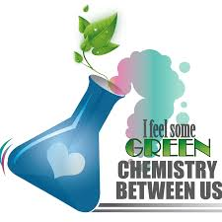
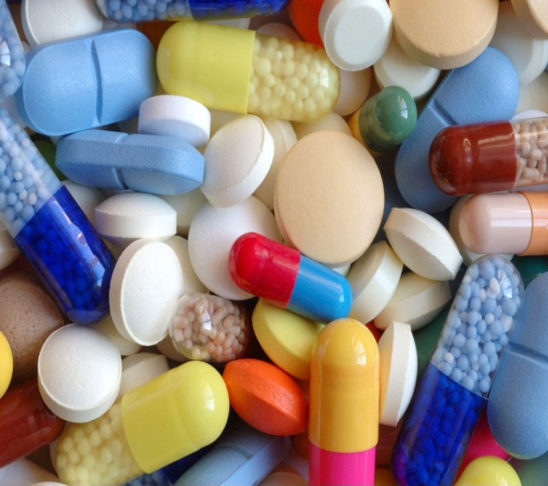
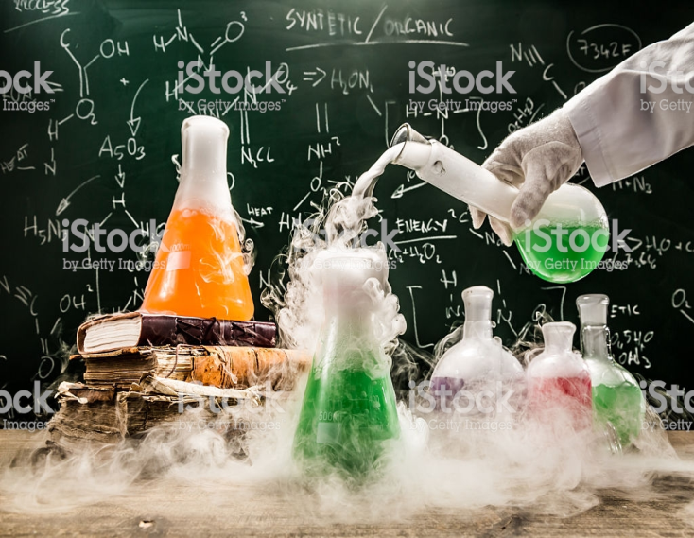
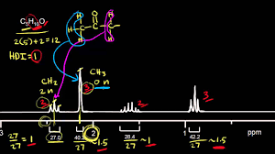

Slide 19
Thank you……
Aug 21,2019

